Slide 1

Database for the Online Auto Part Store

Slide 2
Contribution:
Step 1) System Requirements and functional requirements
Step 2) Construction of ER model and normalization of data
Step 3) Backend Design
Step 4) Front End Design
Step 5) Distributed pages amongst team members:
Step 6) Connection of front end to backend
Step 7) Testing

Slide 3
Project Description:
Technology:
Programming Language:
The programming language HTML, CSS, PHP, Javascript, SQL, Ajax, JSON and Jquery will work with the latest version of WAMPP or XAMPP
Back-End Programming:
We will use MySQL version 5.5.19 for database programming.

Slide 4
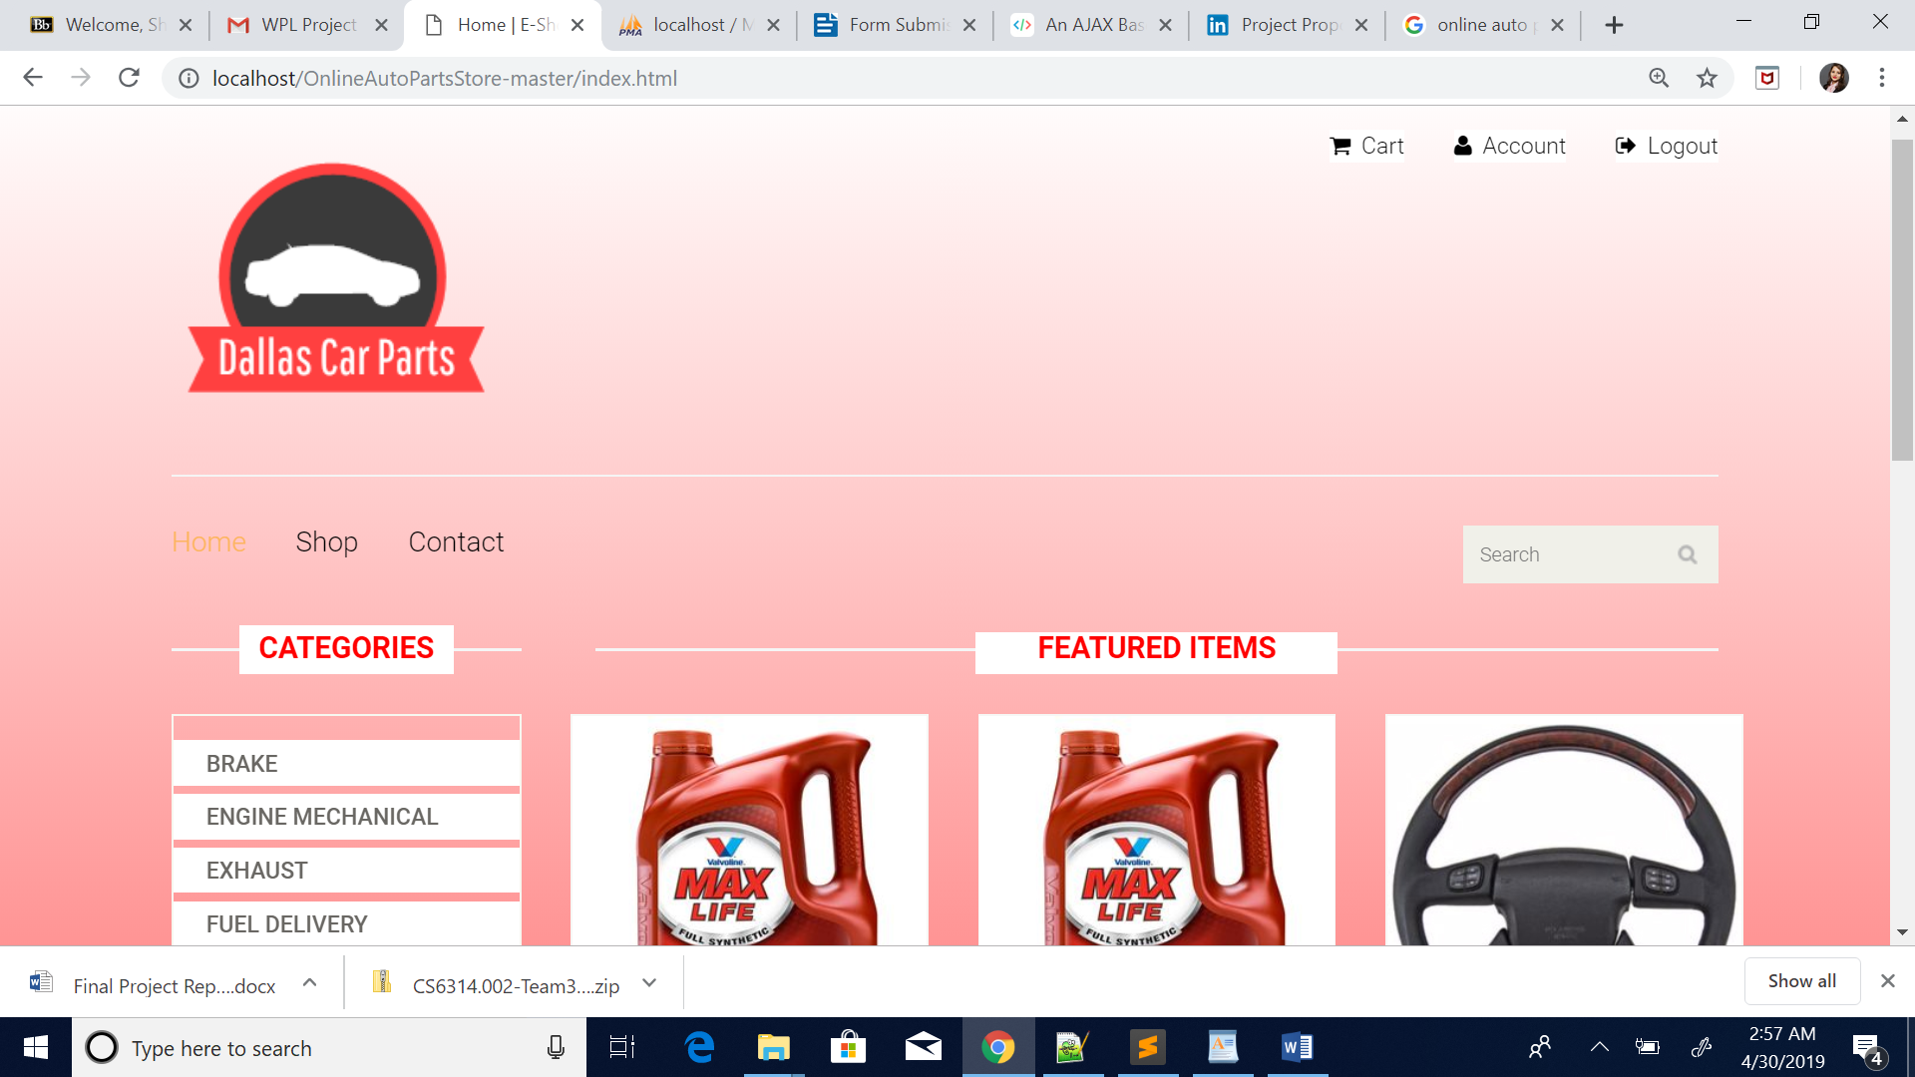

Slide 5
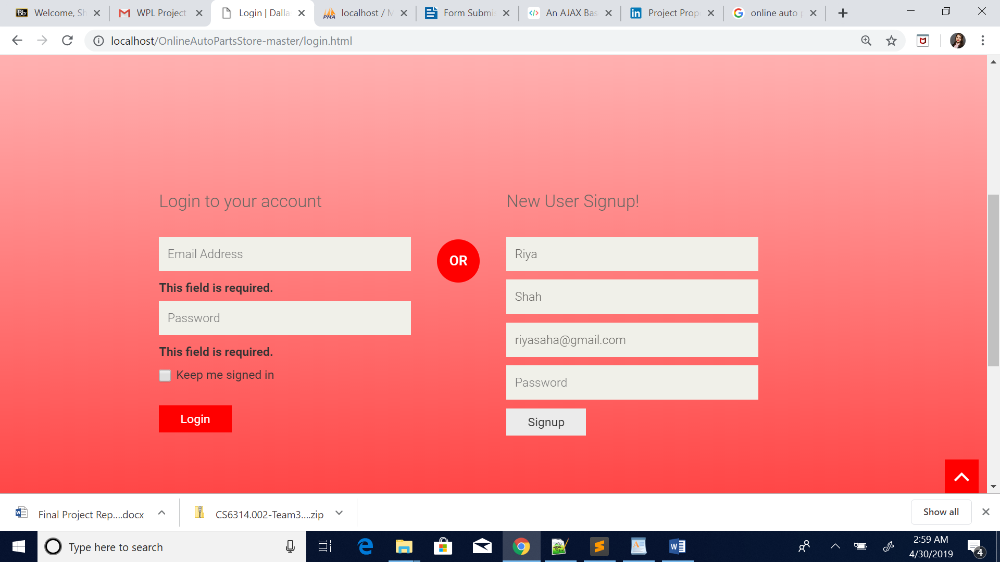

Slide 6
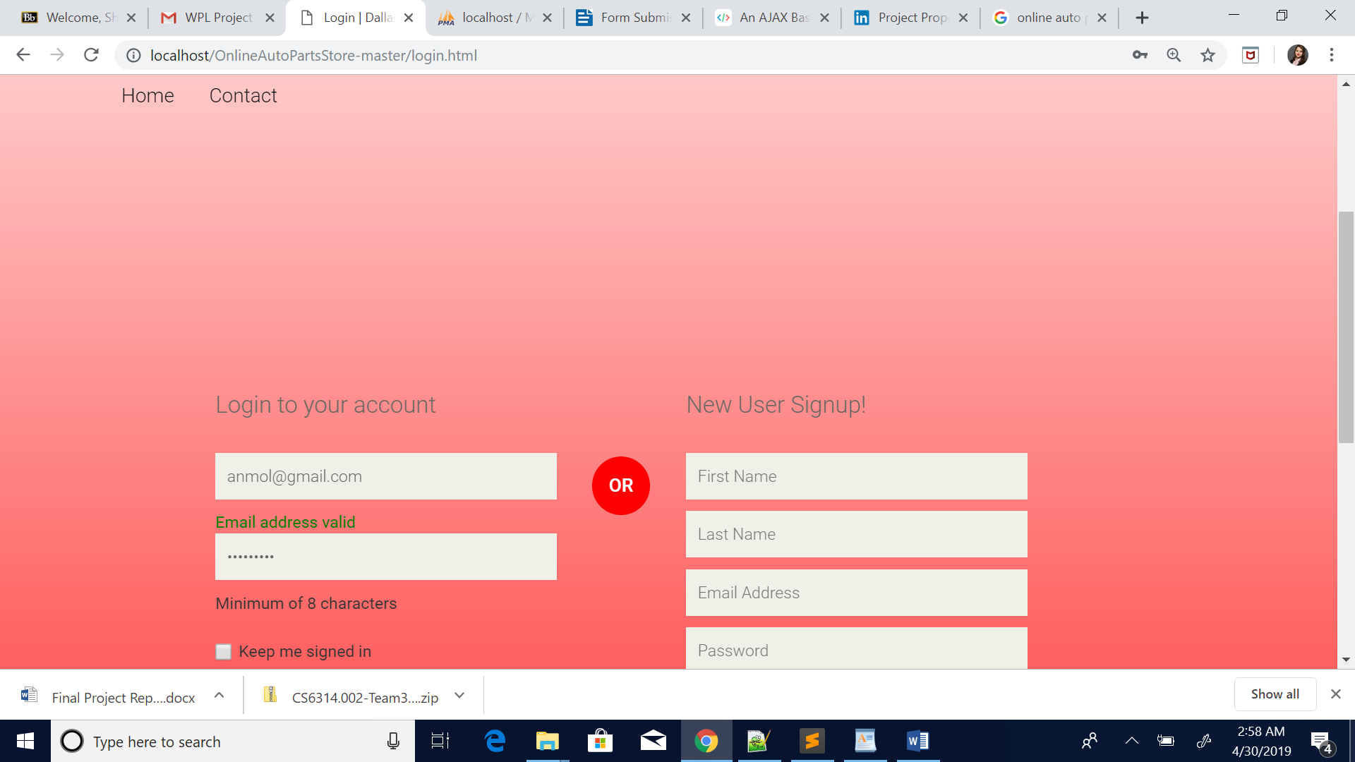

Slide 7
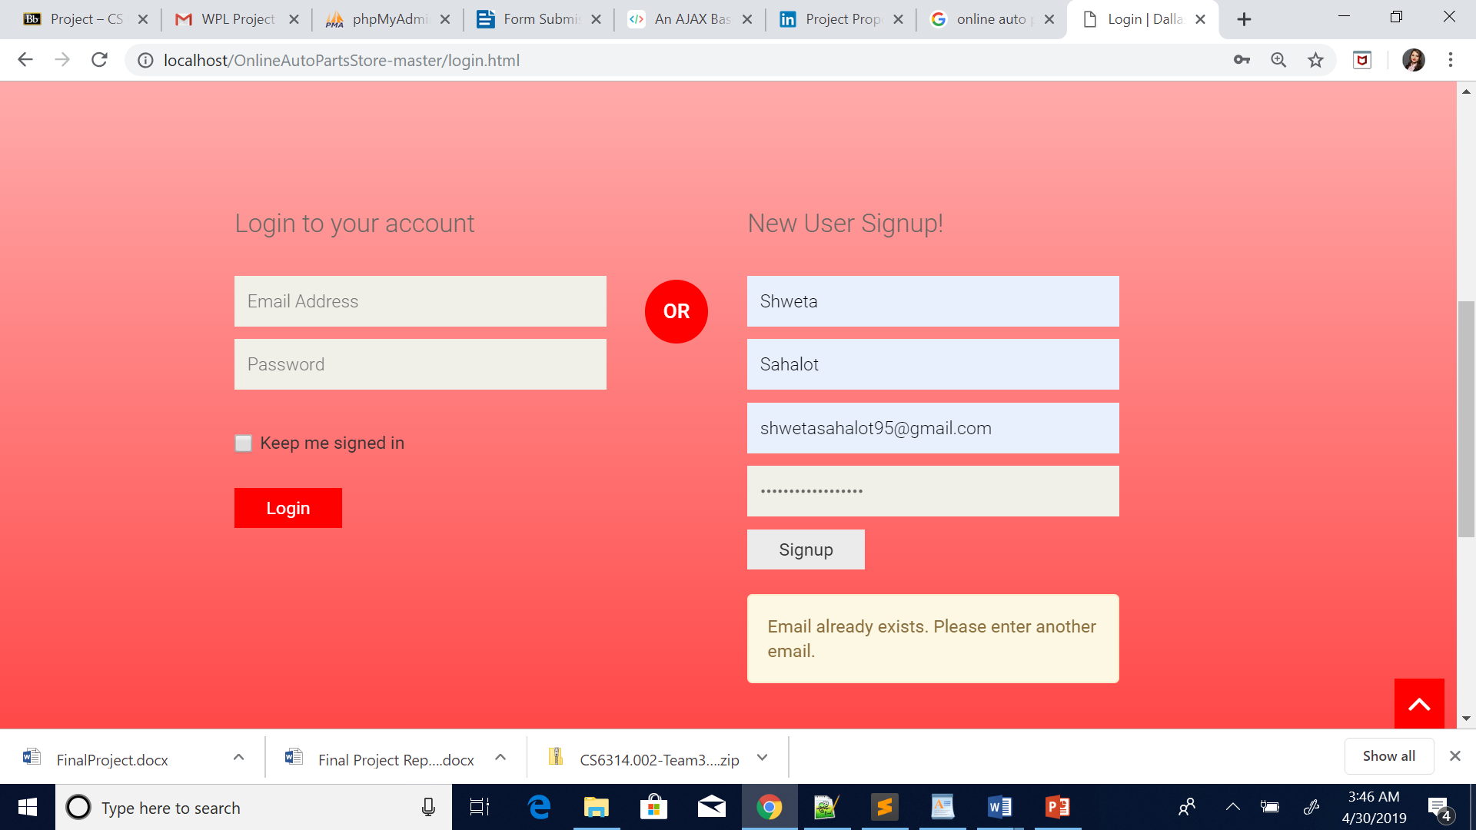

Slide 8
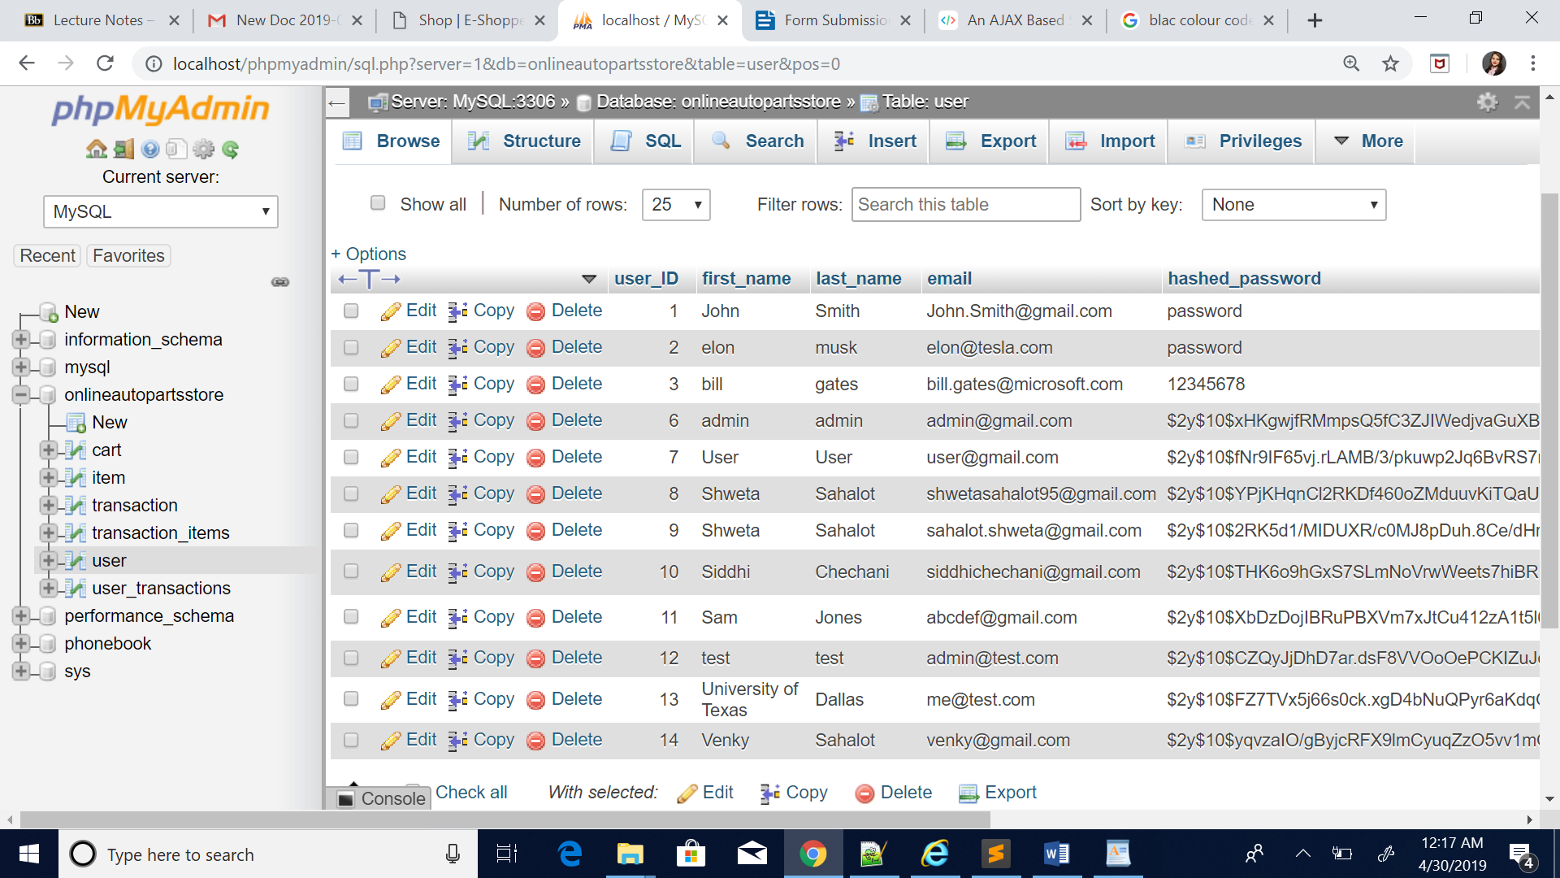

Slide 9
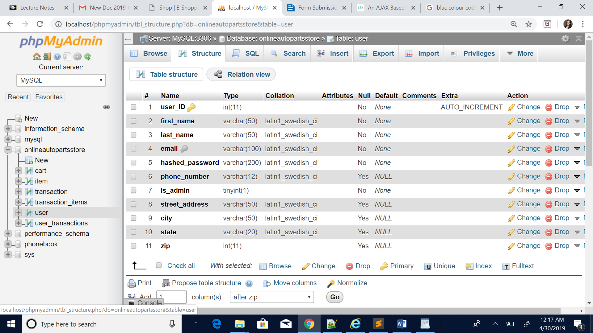

Slide 10
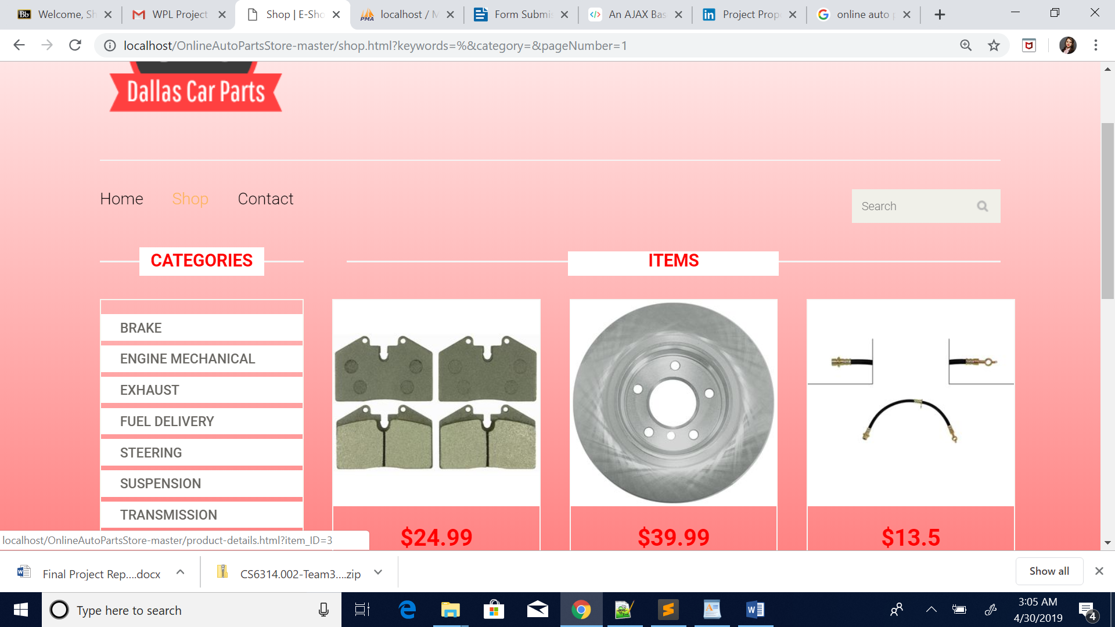

Slide 11
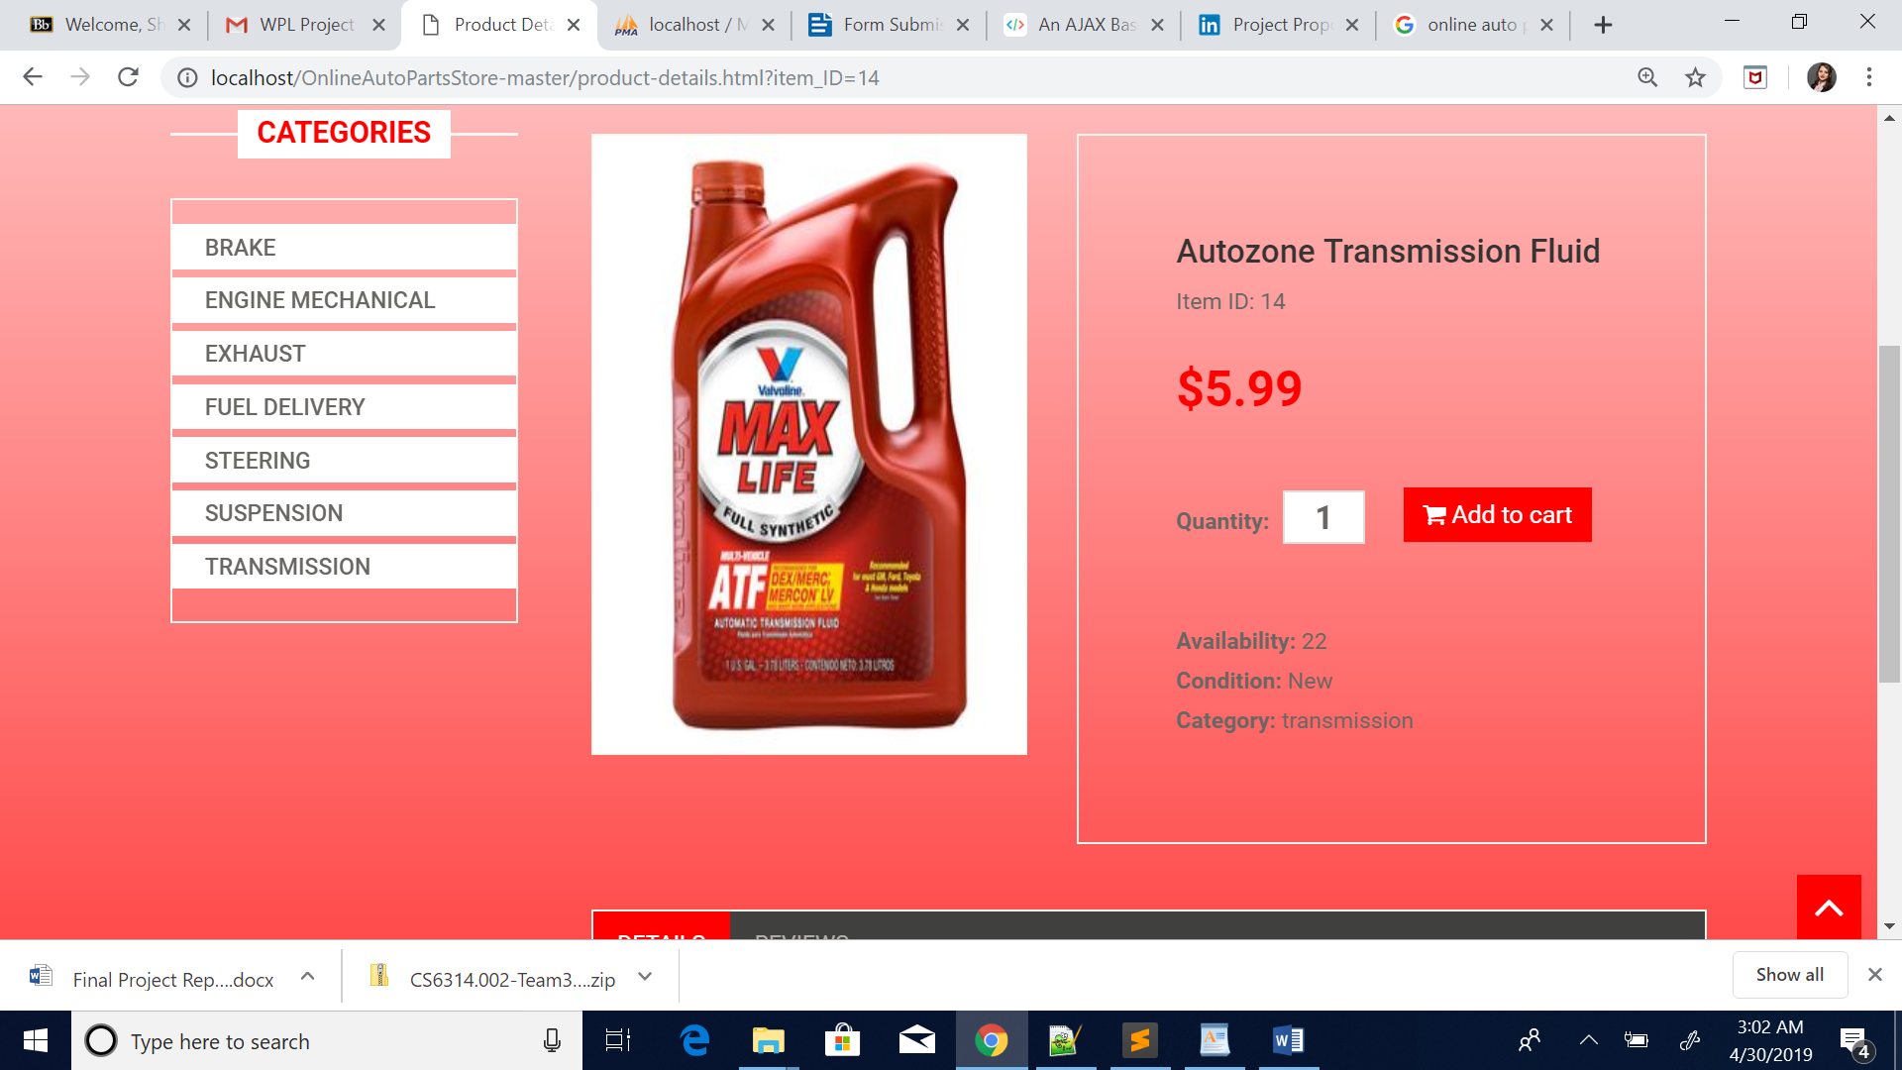

Slide 12
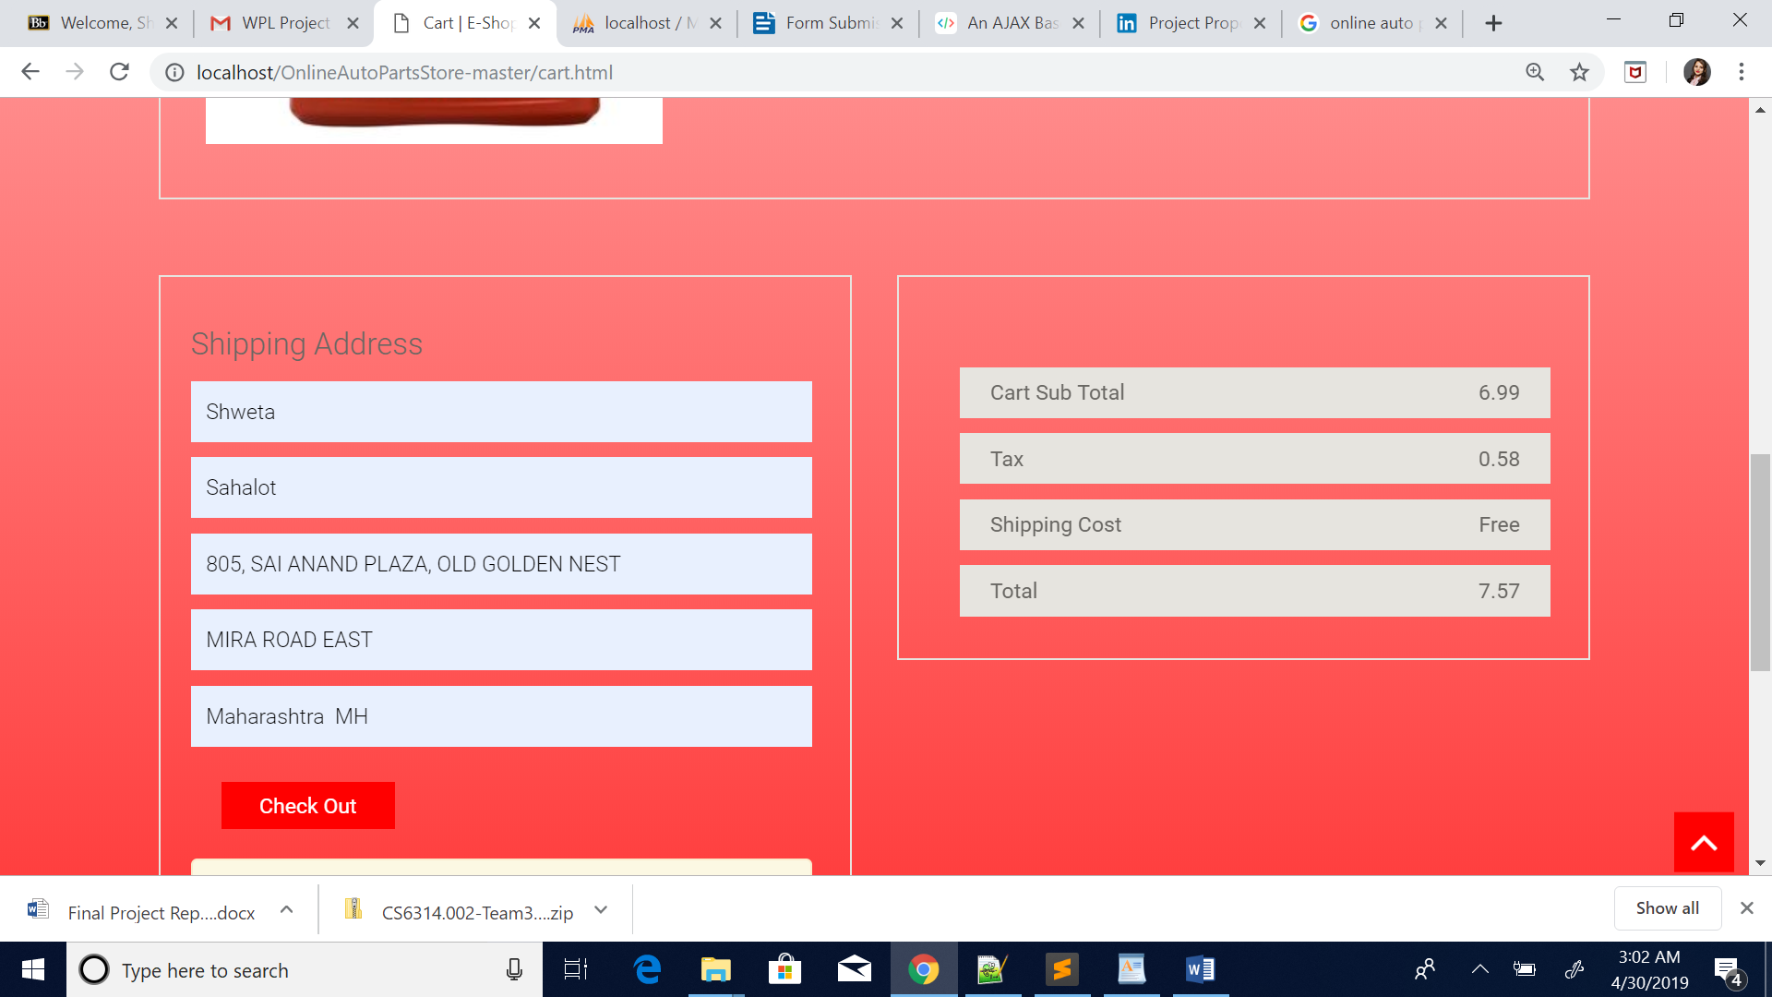

Slide 13
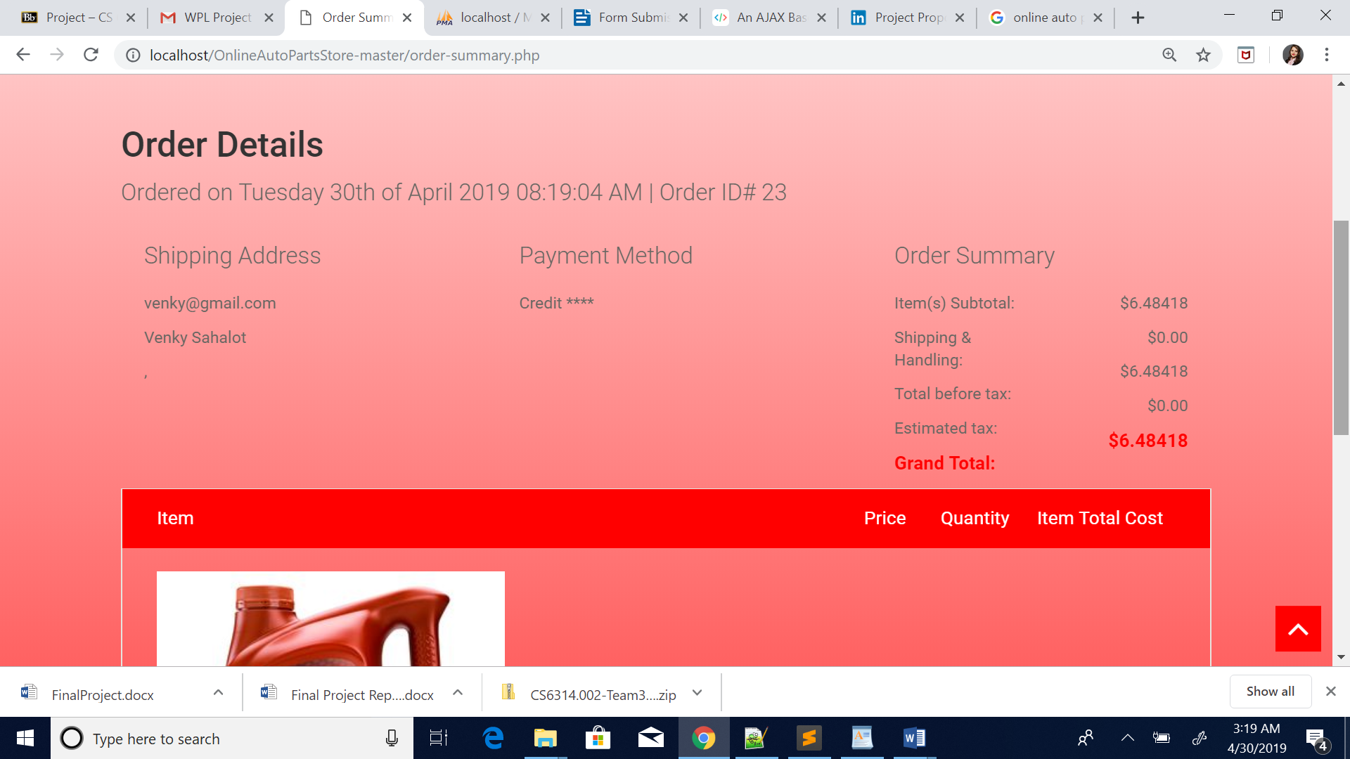

Slide 14
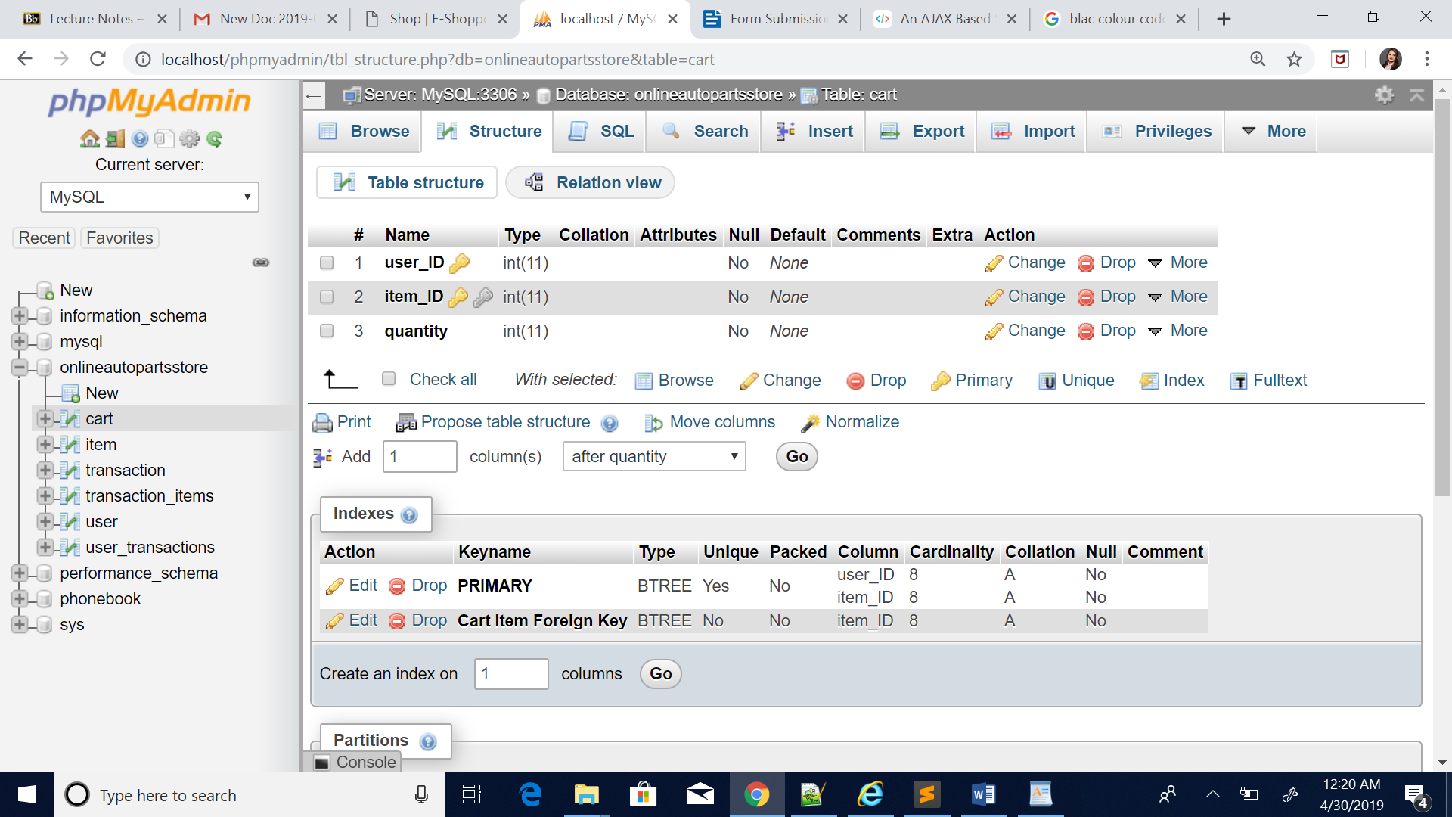
Figure: “onlineautopartsstore” database: cart table structure

Slide 15
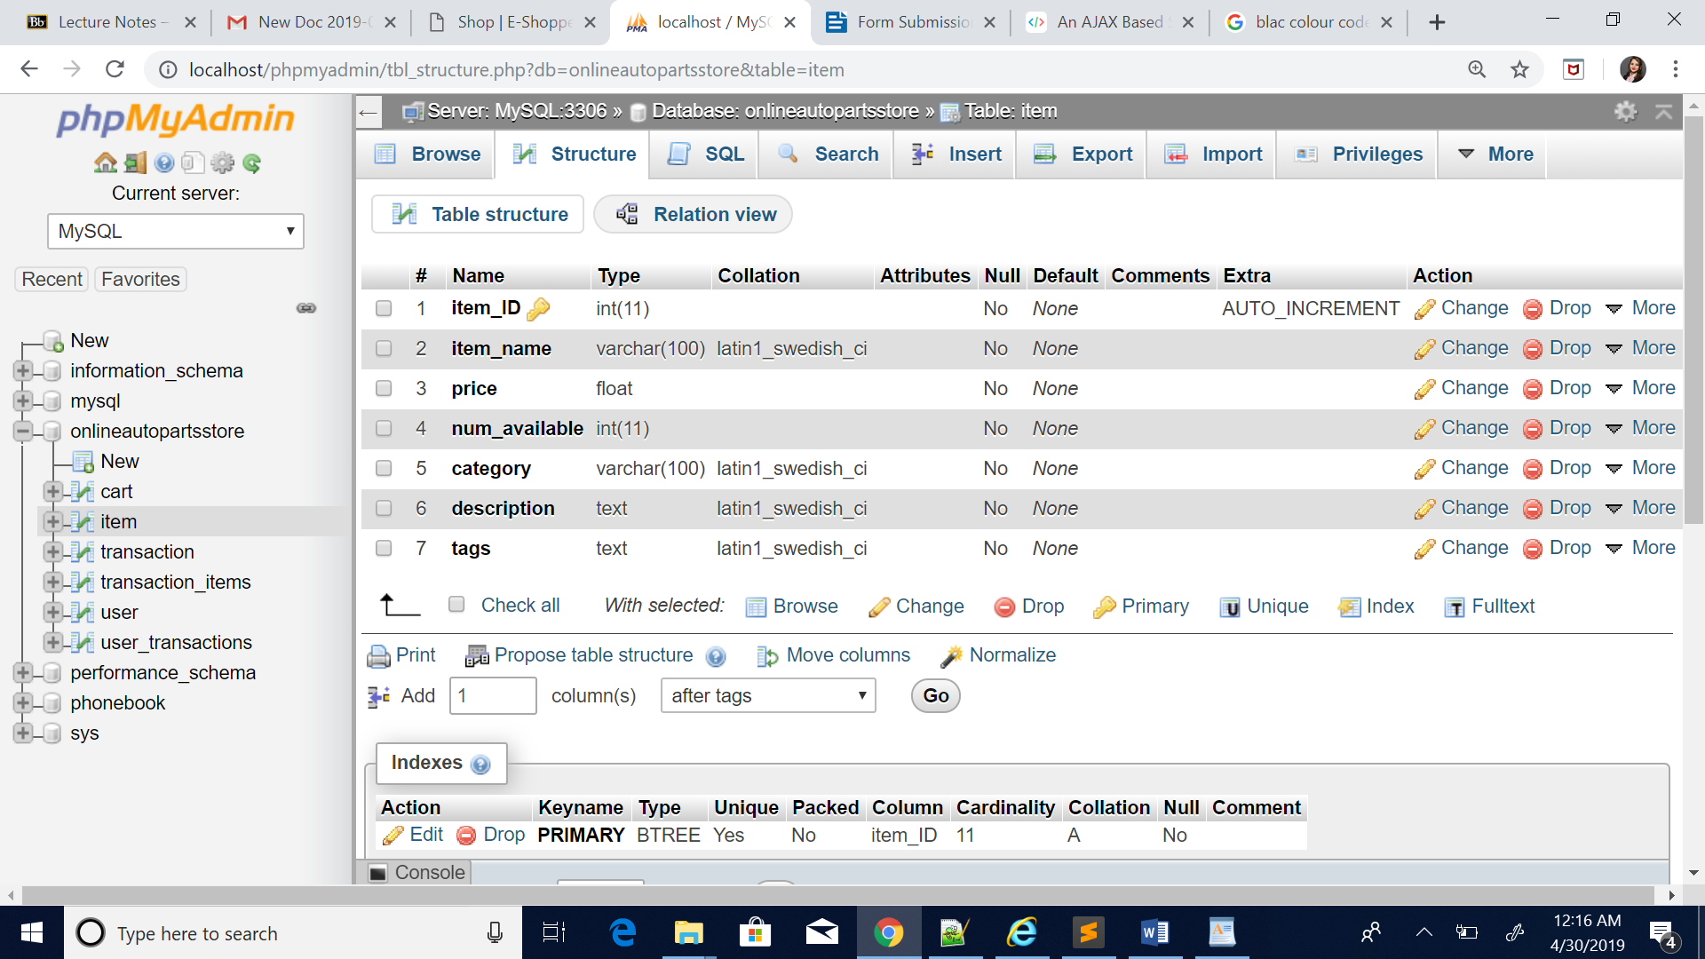
Figure: “onlineautopartsstore” database: item table structure

Slide 16
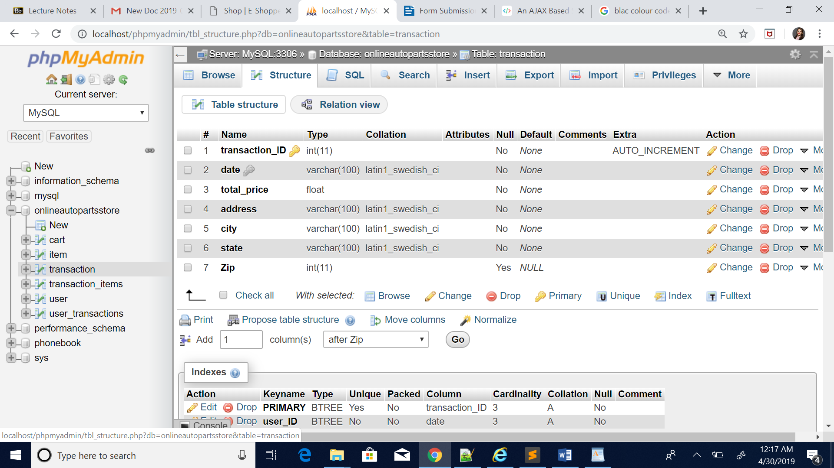
Figure: “onlineautopartsstore” database: transaction table data

Slide 17
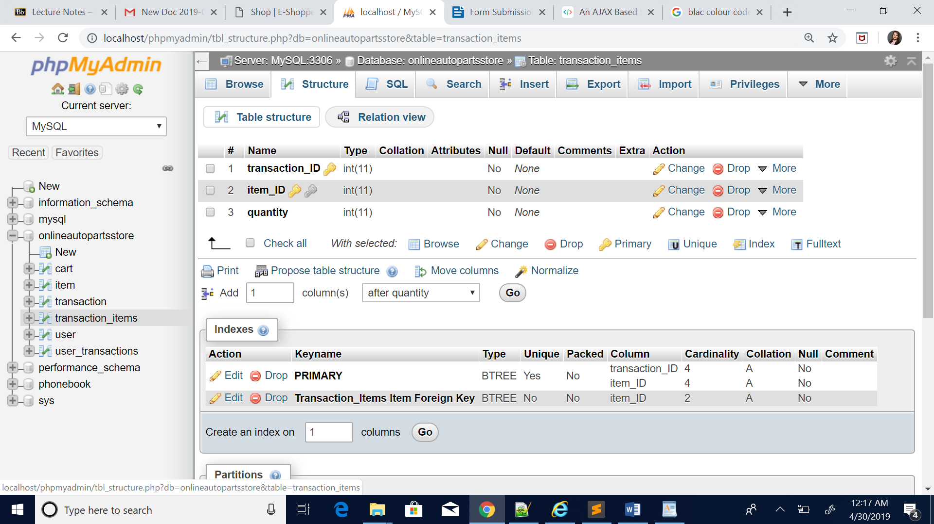
Figure: “onlineautopartsstore” database: transaction_items table structure

Slide 18
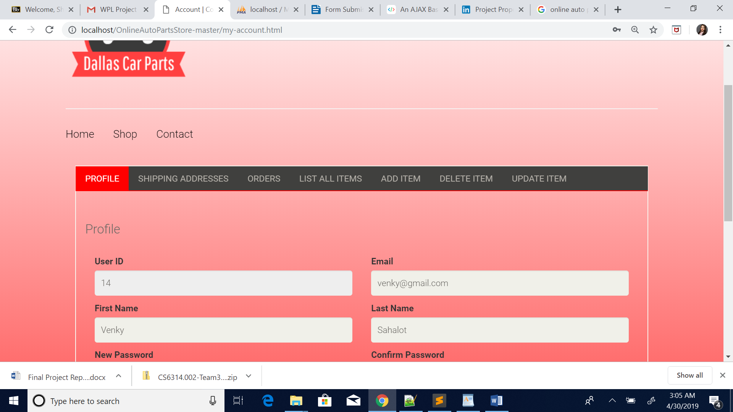

Slide 19
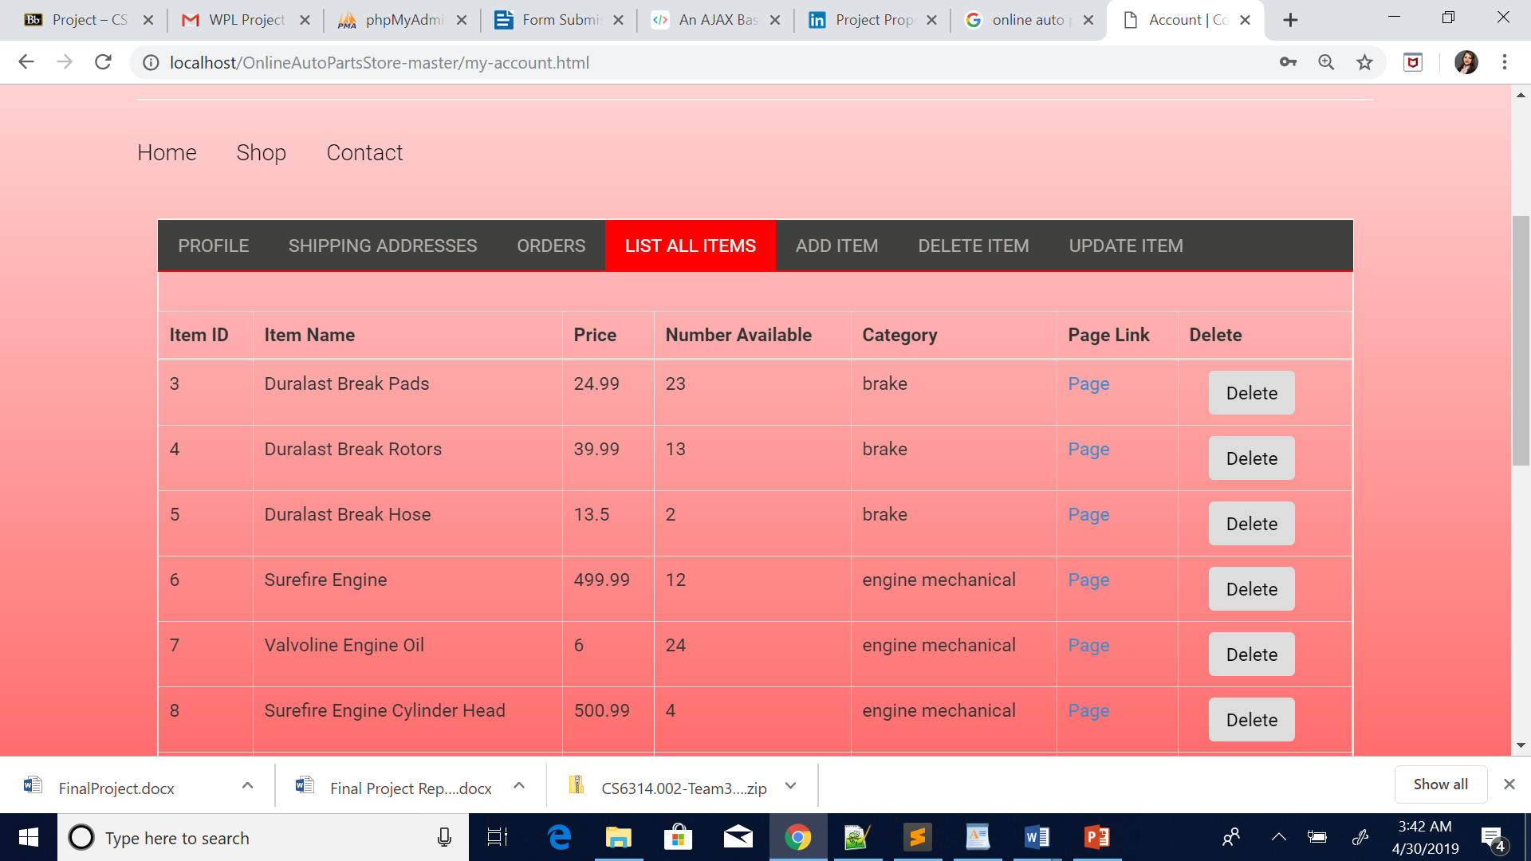

Slide 20
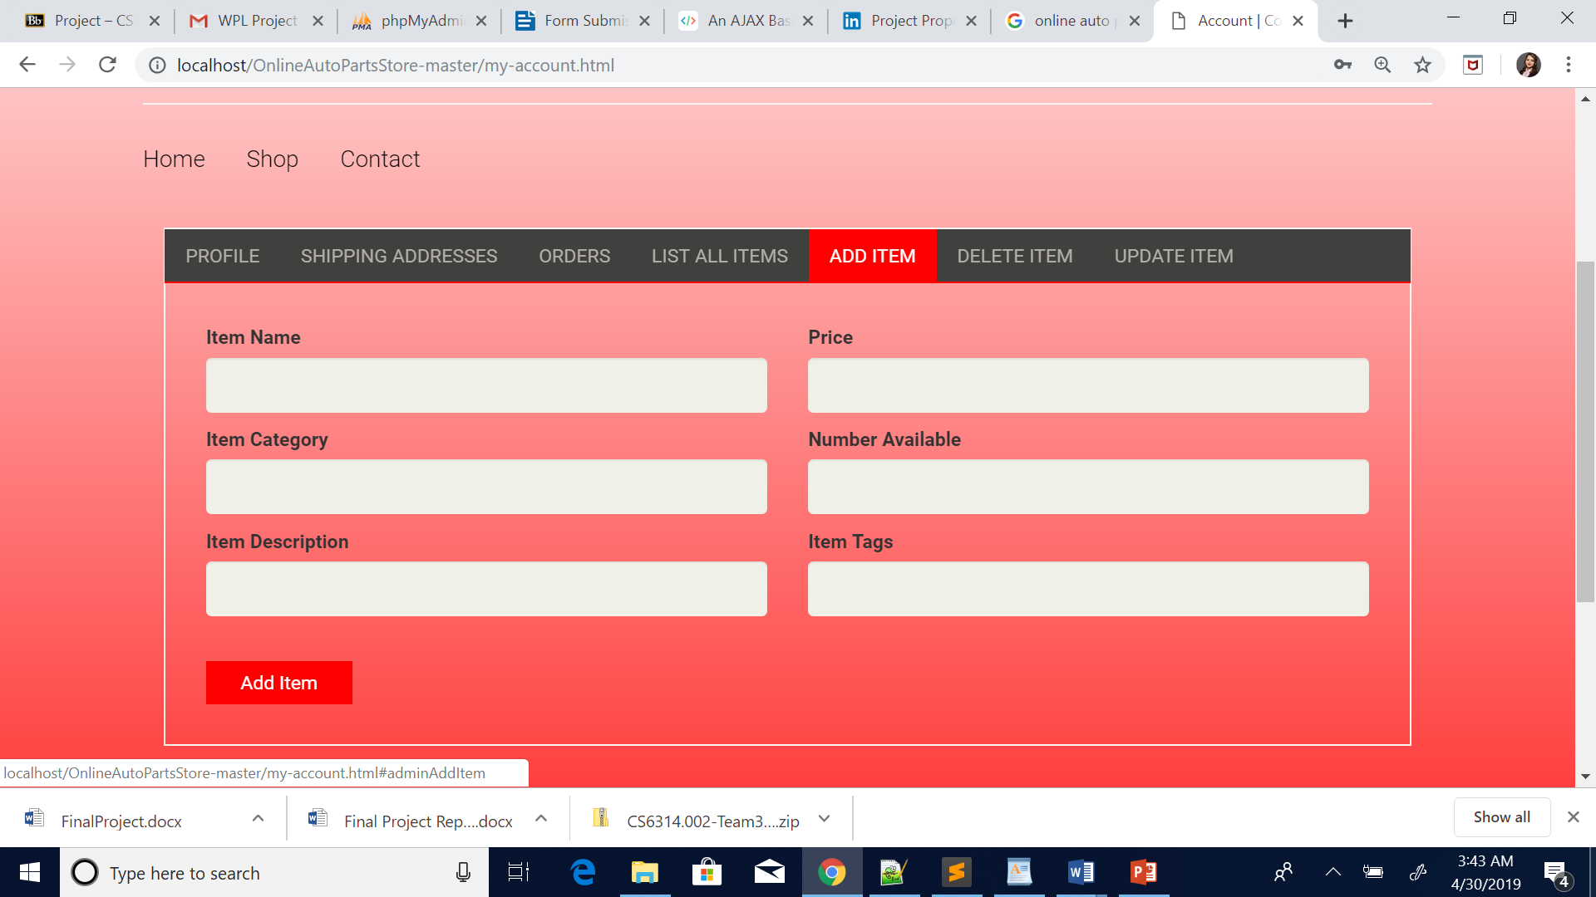

Slide 21
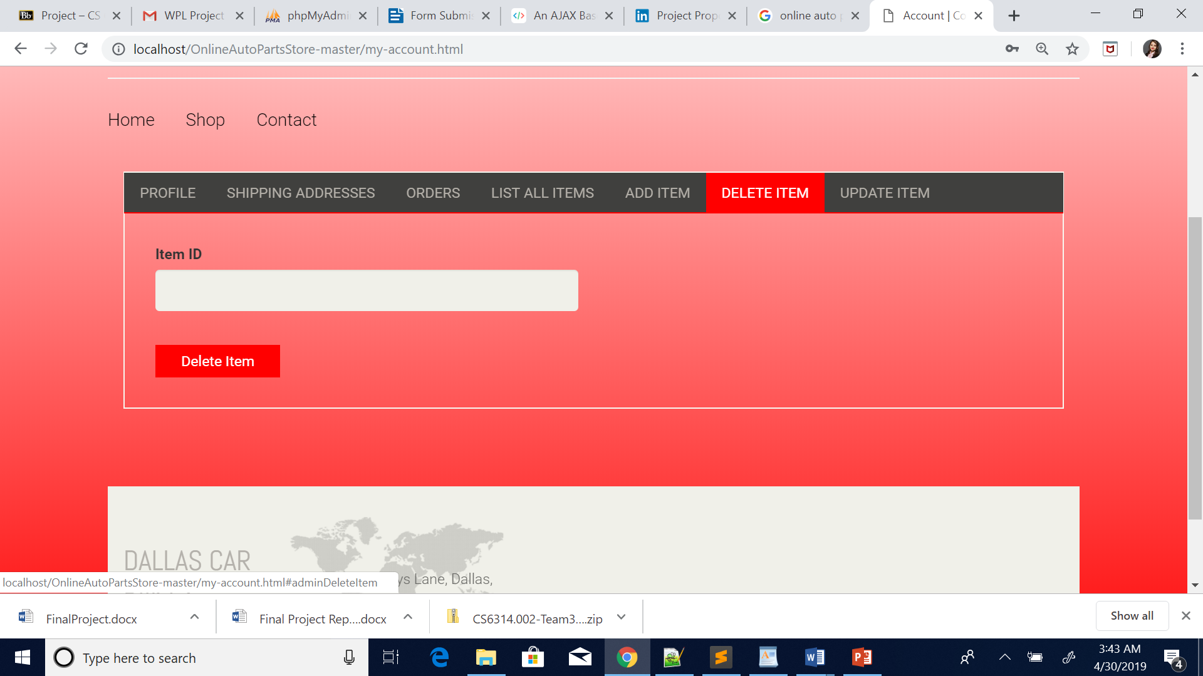

Slide 22
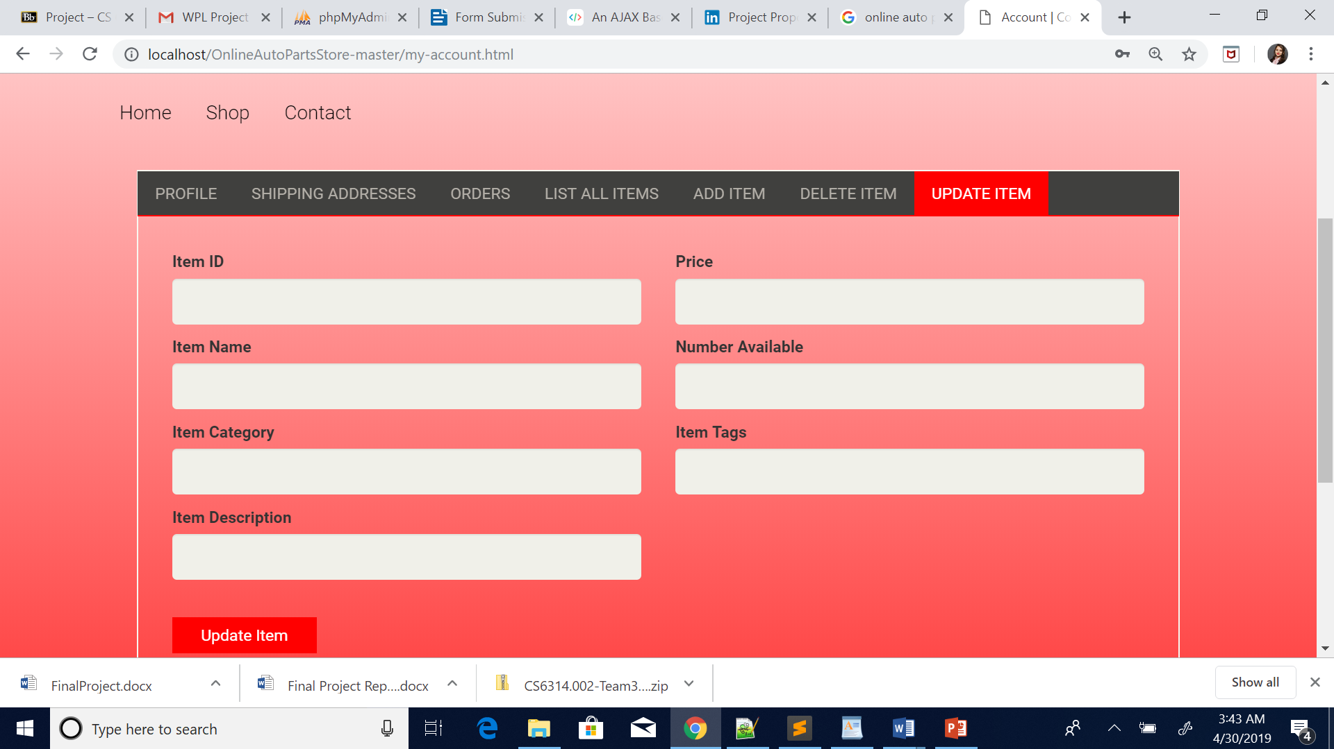

Slide 25
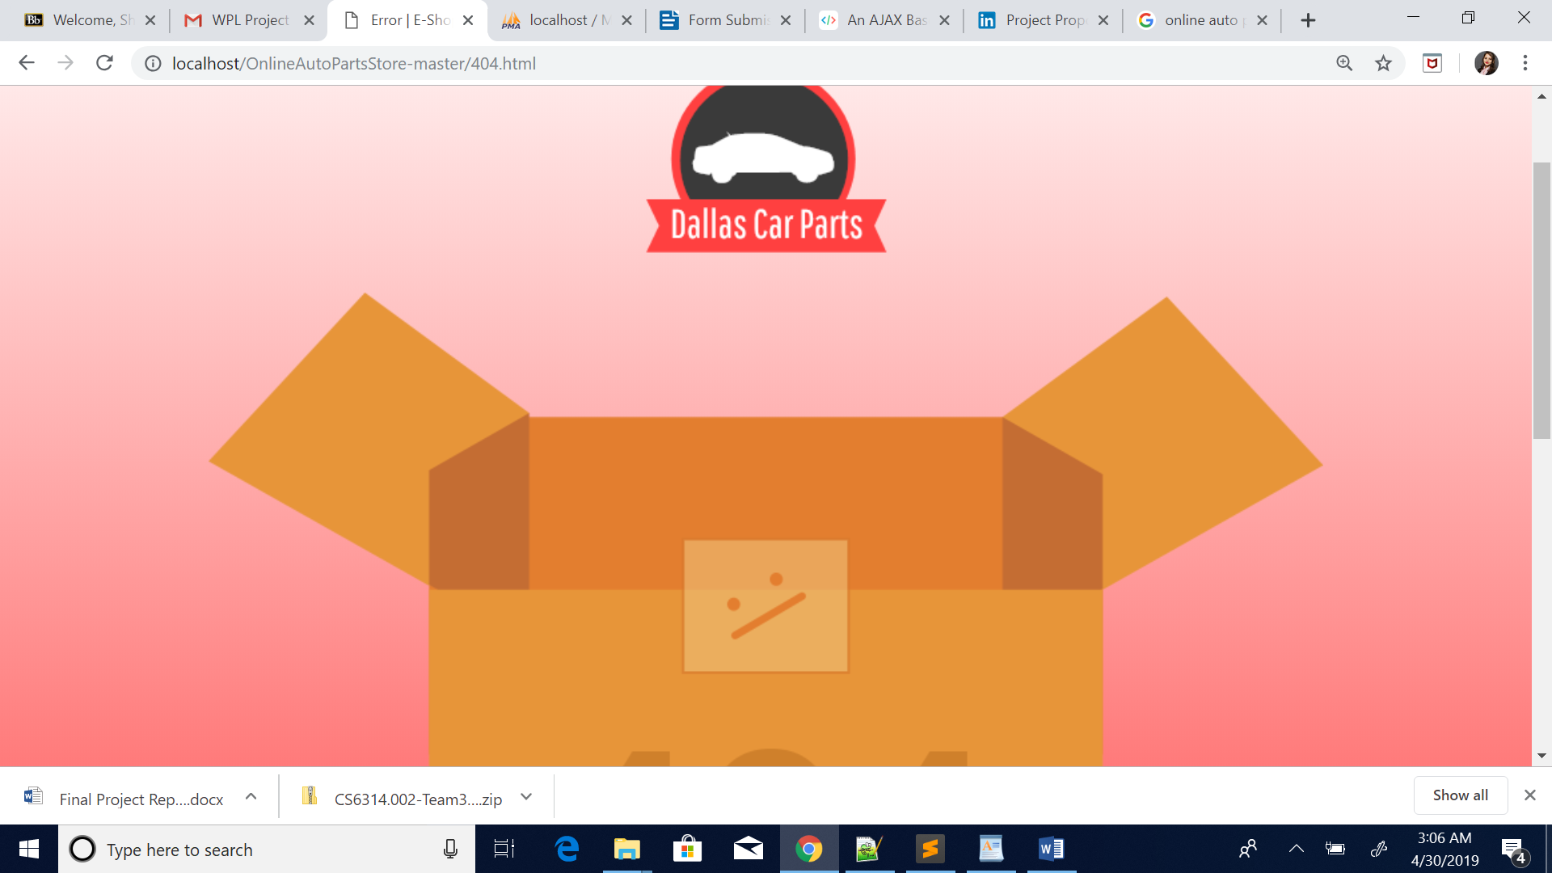

Slide 26
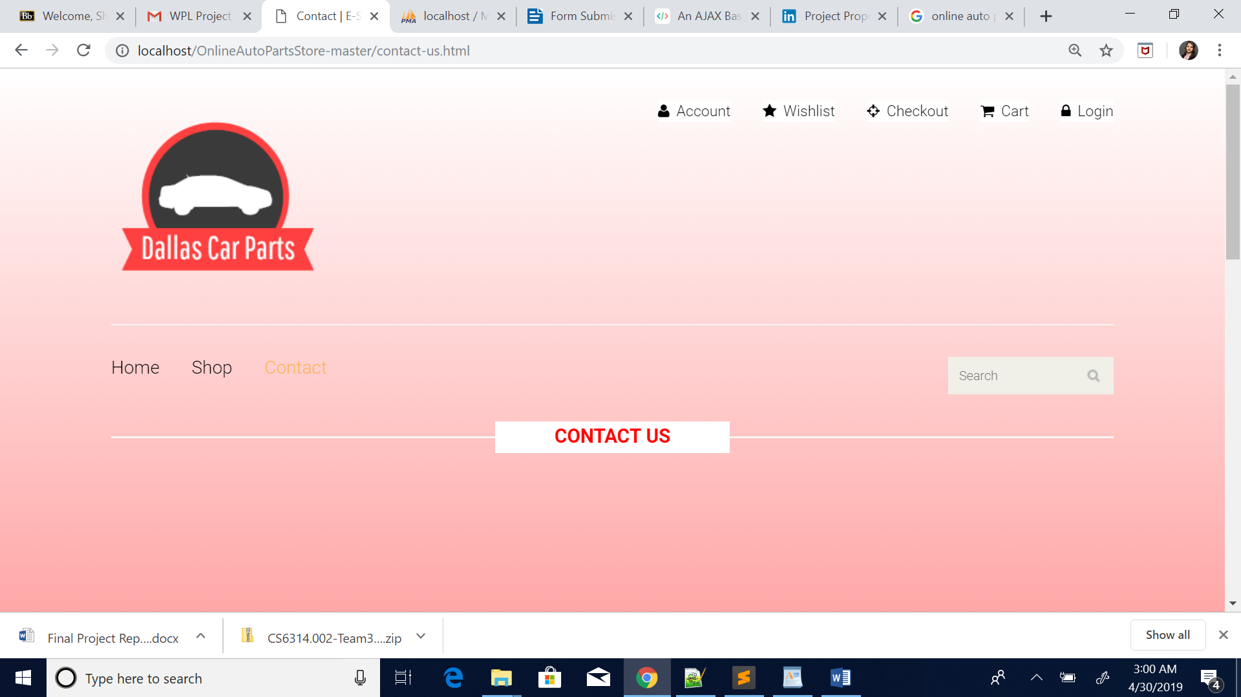

Slide 27
Team Members:
Sr No | Name | Net Id | Contribution
1. | Shweta Rakesh Sahalot | Sxs180145 | Purchase and checkout functionalities
2. | Siddhi Chechani | Sxc170042 | Login, logout validation, account handling
3. | Anmol Mittal | Axm170059 | Admin and Styling functionalities

